Slide 1

Cloud Computing
Mini Project
AWS Cloudshell
Karishma Bairi TU3F1920014 TE-A-15
Shweta Kaware TU3F1920005 TE-A-06
Abhishek Eitkar TU3F1920013 TE-A-14
UNDER THE GUIDANCE OF
Prof. Smita Pai

Slide 2
CONTENTS…
1.INTRODUCTION
2. NEED OF PROJECT
3. METHODOLOGY
4. RESULT
5. CONCLUSION
6.REFERENCES

Slide 3
INTRODUCTION
What is AWS Cloudshell?
AWS CloudShell is a browser-based shell that makes it easy to securely manage, explore, and interact with your AWS resources. CloudShell is pre-authenticated with your console credentials. Common development and operations tools are pre-installed, so no local installation or configuration is required..

Slide 4
Need of AWS Cloudshell
With CloudShell, you can quickly run scripts with the AWS Command Line Interface (AWS CLI), experiment with AWS service APIs using the AWS SDKs, or use a range of other tools to be productive.
You can use CloudShell right from your browser and at no additional cost.

Slide 5
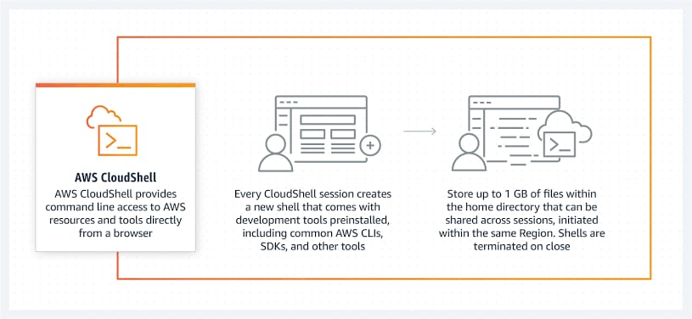
Methodology

Slide 6
Step 1: Sign in to AWS Management Console. Step 2: Launch AWS CloudShell, select a Region, and choose a shell. Step 3: Upload a file to AWS CloudShell. Step 4: Edit your file's code and run it from the command line. Step 5: Use AWS CLI to add the file as an object in an Amazon S3 bucket.

Slide 7
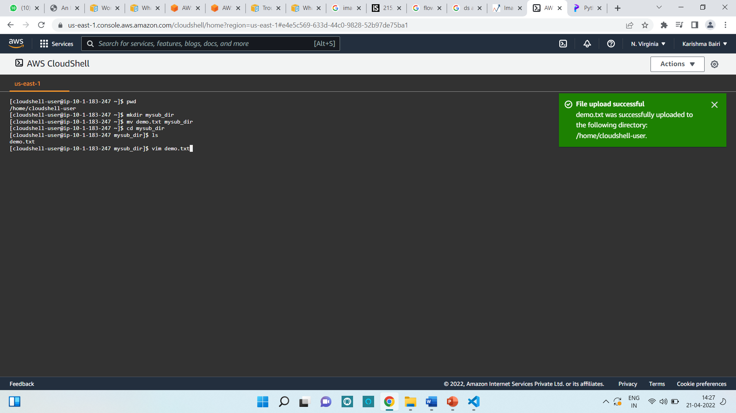
Result

Slide 8
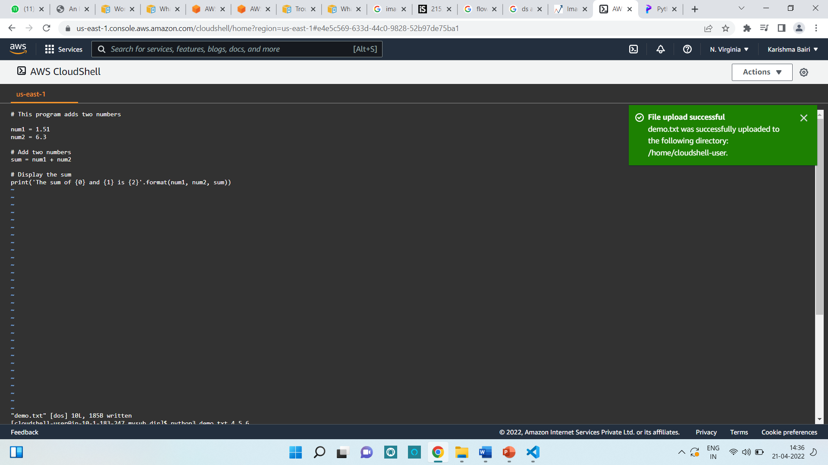

Slide 9
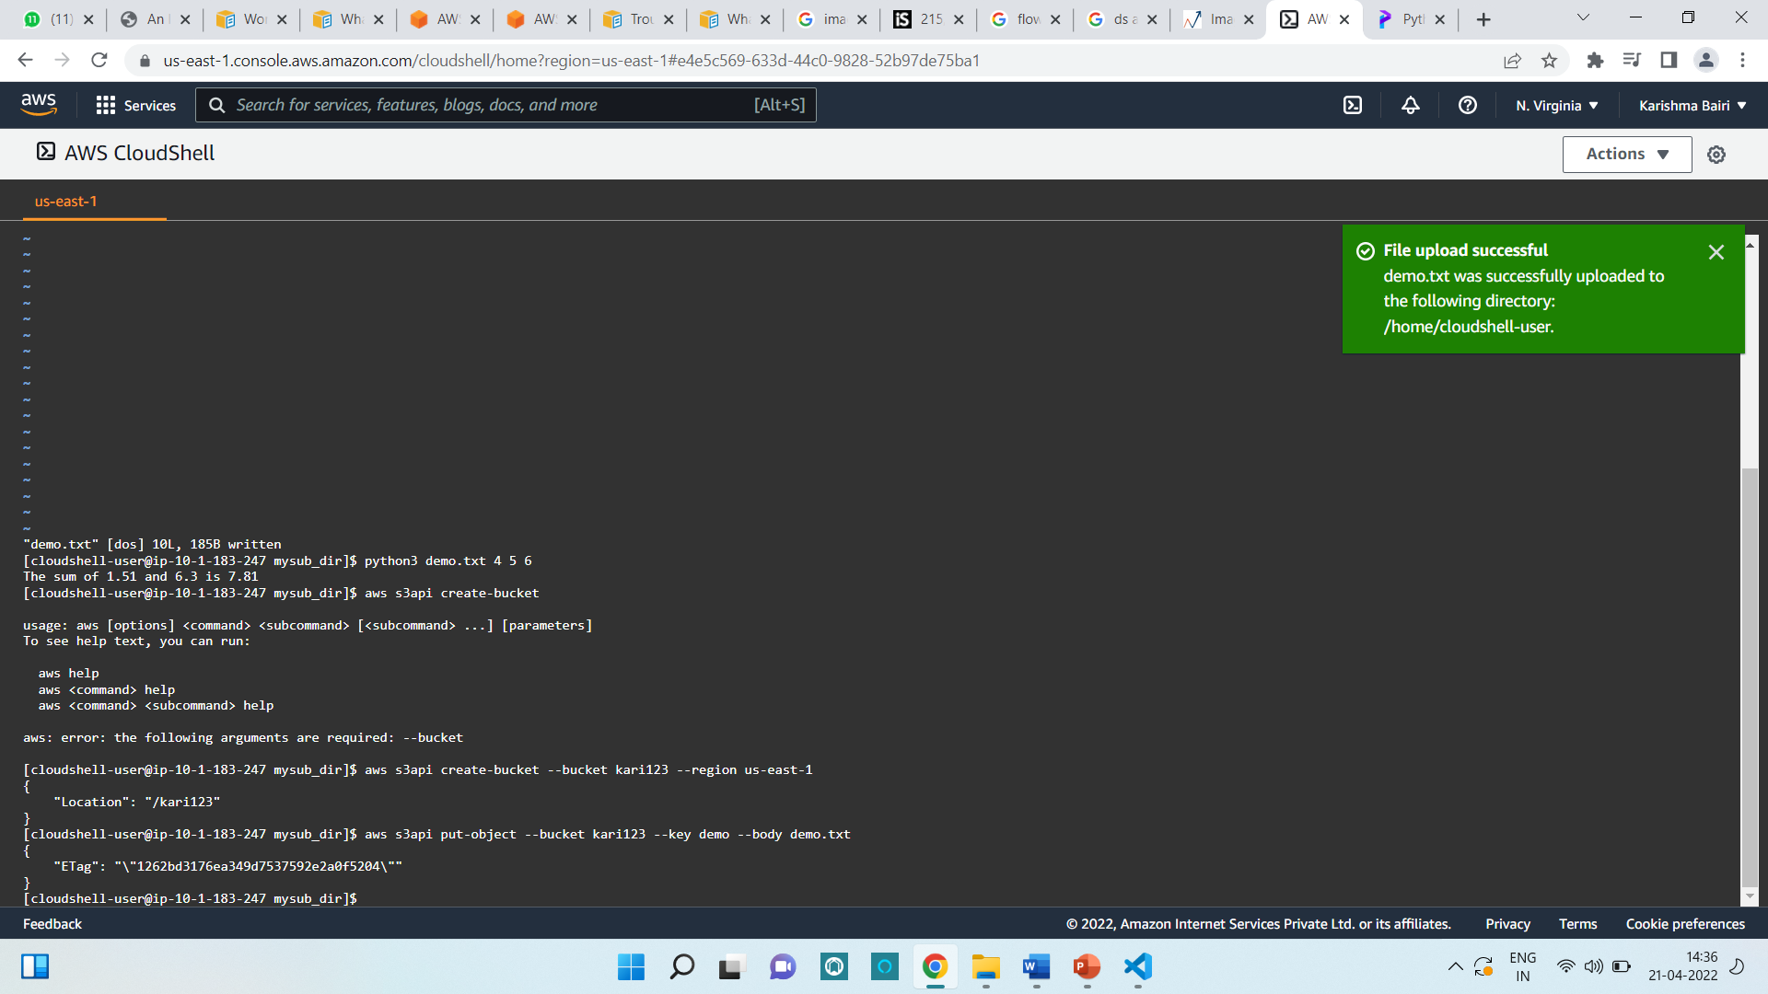

Slide 10
CONCLUSION
The AWS CloudShell is a useful service if you want a quick shell that is pre-configured to work with your AWS console credentials without having to generate IAM keys. It is quite cost-effective since you only have to pay for what you use.
It also offers 12 month free trials for its first users so that they get engaged and understand how it works, and then as per business requirements.
Apart from cost-effectiveness, SES is backed by Amazon Web Services, allowing you to integrate third-party plugins so that you don't have to rely only on Amazon.

Slide 11
REFERENCES
https://docs.aws.amazon.com/cloudshell/latest/userguide/getting-started.html
https://deliciousbrains.com/ses-vs-mailgun-vs-sendgrid/
https://aws.amazon.com/cloudshell/
https://cloud.google.com/shell

Slide 12
THANK YOU !

